Slide 1

University Of New Haven Emojify Under the guidance of Professor: Dr.Shivanjali Khare Submitted by Krishna Surendra Palepu Bharath Veer Bootla Naveen Kumar Nettem

Slide 2
Table of Contents
Introduction
Objectives
Approach
Facial Emotions
Libraries Used
Deliverables
CNN, R-CNN, LSTM
ARCHITECTURE
RESULTS

Slide 3

Introduction
A tiny digital image or icon known as a "Emoji" is used in electronic communication to convey a thought or feeling.
In the past year, emojis have gained such popularity that many businesses now experience "FOMO," as Dr. Freberg may put it. The term "Fear of Missing Out" (FOMO) is especially apparent in the latest emoji marketing. Despite the fact that our culture is dependent on emoji usage in text, the emoji phenomenon began in 2001 with the introduction of the first smartphones.

Slide 4
OBJECTIVE
Nowadays, a variety of emojis or avatars are used to express our emotions or feelings, serving as nonverbal cues in communication. They play a critical role in recognizing emotions, internet communication, brand emotion, product reviews, and other similar activities.
Advancements in deep learning and computer vision technologies, detecting human emotions from photographs has become feasible.
Our deep learning research aims to categorize human facial expressions to identify and match the appropriate emojis.

Slide 5

APPROACH
We are developing a deep learning model that can identify human facial expressions and match them to the appropriate emojis.
The FER2013 dataset is a popular dataset for facial expression recognition research. It contains over 30,000 images of faces with different expressions. The images are labeled with one of seven emotions: angry, disgusted, fearful, happy, sad, surprised, or neutral.

Slide 6
FACIAL EMOTIONS
ANGRY
Sad
Surprise
Fear
Natural
Happy

Slide 7
LIBRARIES USED:
Pandas
NumPy
CV2
datetime
TensorFlow
Tkinter
OS
Seaborn
Matplotlib

Slide 8

DELIVERABLES
We will develop a convolution neural network to recognize face emotions. After that, we use the dataset into our model. Finally, we associate each facial emotion with the appropriate emojis or avatars.
Sample output images
Git hub Repository with all documentation and code
You tube link which demonstrates our work

Slide 9

CNN
CONVOLUTIONAL NEURAL NETWORKS
Convolutional Neural Networks (or convnets) are based on the following principles:
Local receptive fields
Shared weights
Pooling (or down-sampling)

Slide 10

R-CNN
R-CNN (regions with convolutional neural networks) combines rectangular region proposals with properties of convolutional neural networks.
The R-CNN algorithm is a two-stage detection method.
The first stage, called region proposal, generates a set of region proposals, which are candidate regions that may contain objects.
The second stage of the R-CNN algorithm, called object classification, classifies each region proposal as either an object or background. This is done by feeding each region proposal to a convolutional neural network (CNN). The CNN is trained to classify objects in images.

Slide 11

LSTM
Long short-term memory (LSTM) is an artificial neural network used in the fields of artificial intelligence and deep learning. Unlike standard feed forward neural networks, LSTM has feedback connections.
LSTM has feedback connections, i.e., it is capable of processing the entire sequence of data, apart from single data points such as images. This finds application in speech recognition, machine translation, etc. LSTM is a special kind of RNN, which shows outstanding performance on a large variety of problems

Slide 12
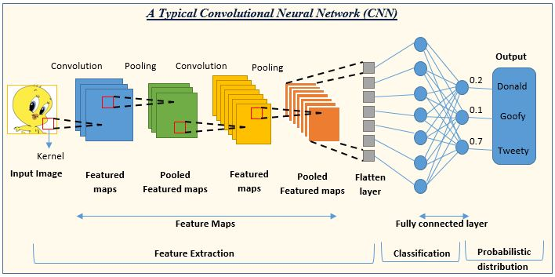
This special neural network architecture takes advantage of the spatial structure of data.

Slide 13
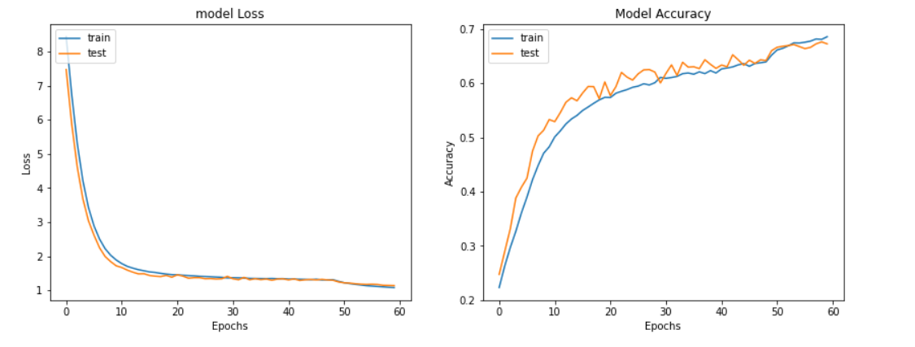
LOSS AND ACCURACY PLOT

Slide 14
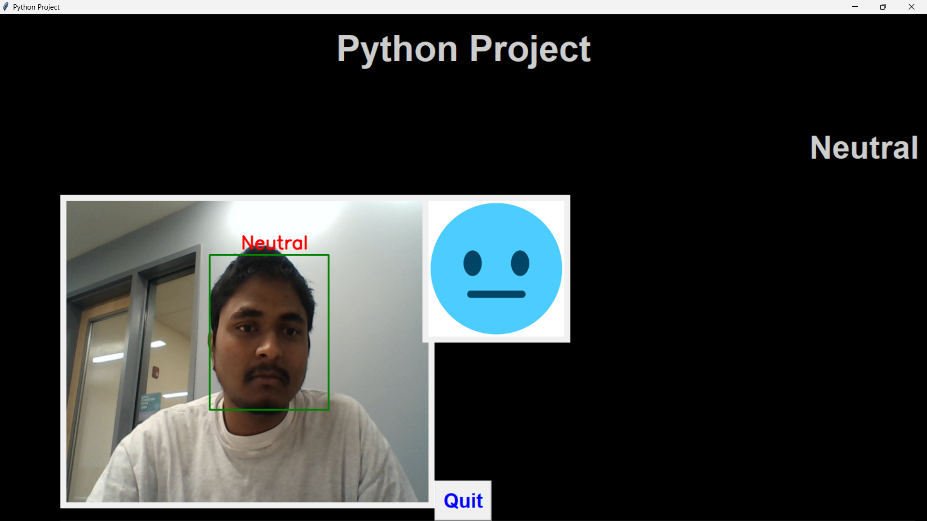
RESULTS

Slide 15
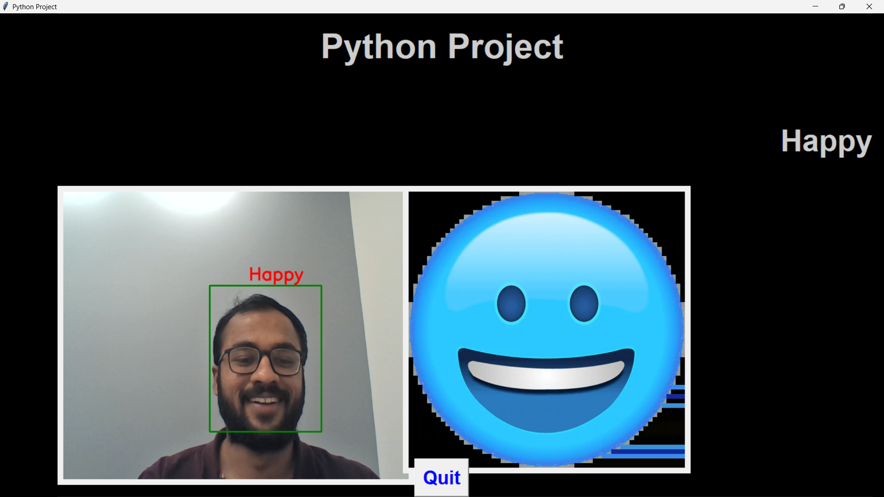
RESULTS

Slide 16
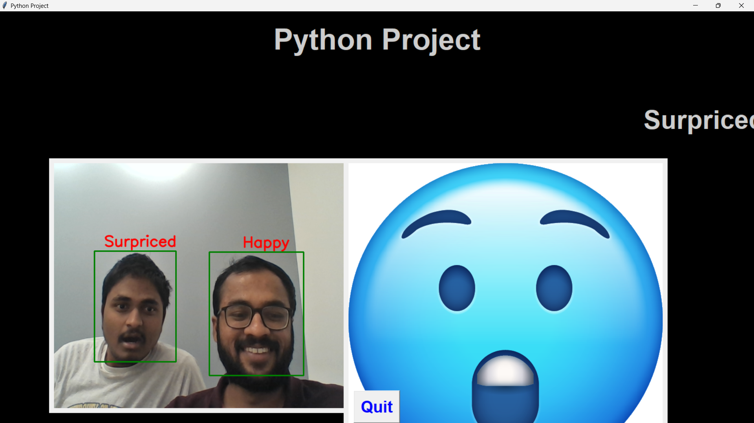
RESULTS

Slide 17

Thank You!

